Slide 1

Working Smarter on the Skills Agenda
Practical strategies for progressive L&D professionals

Slide 2
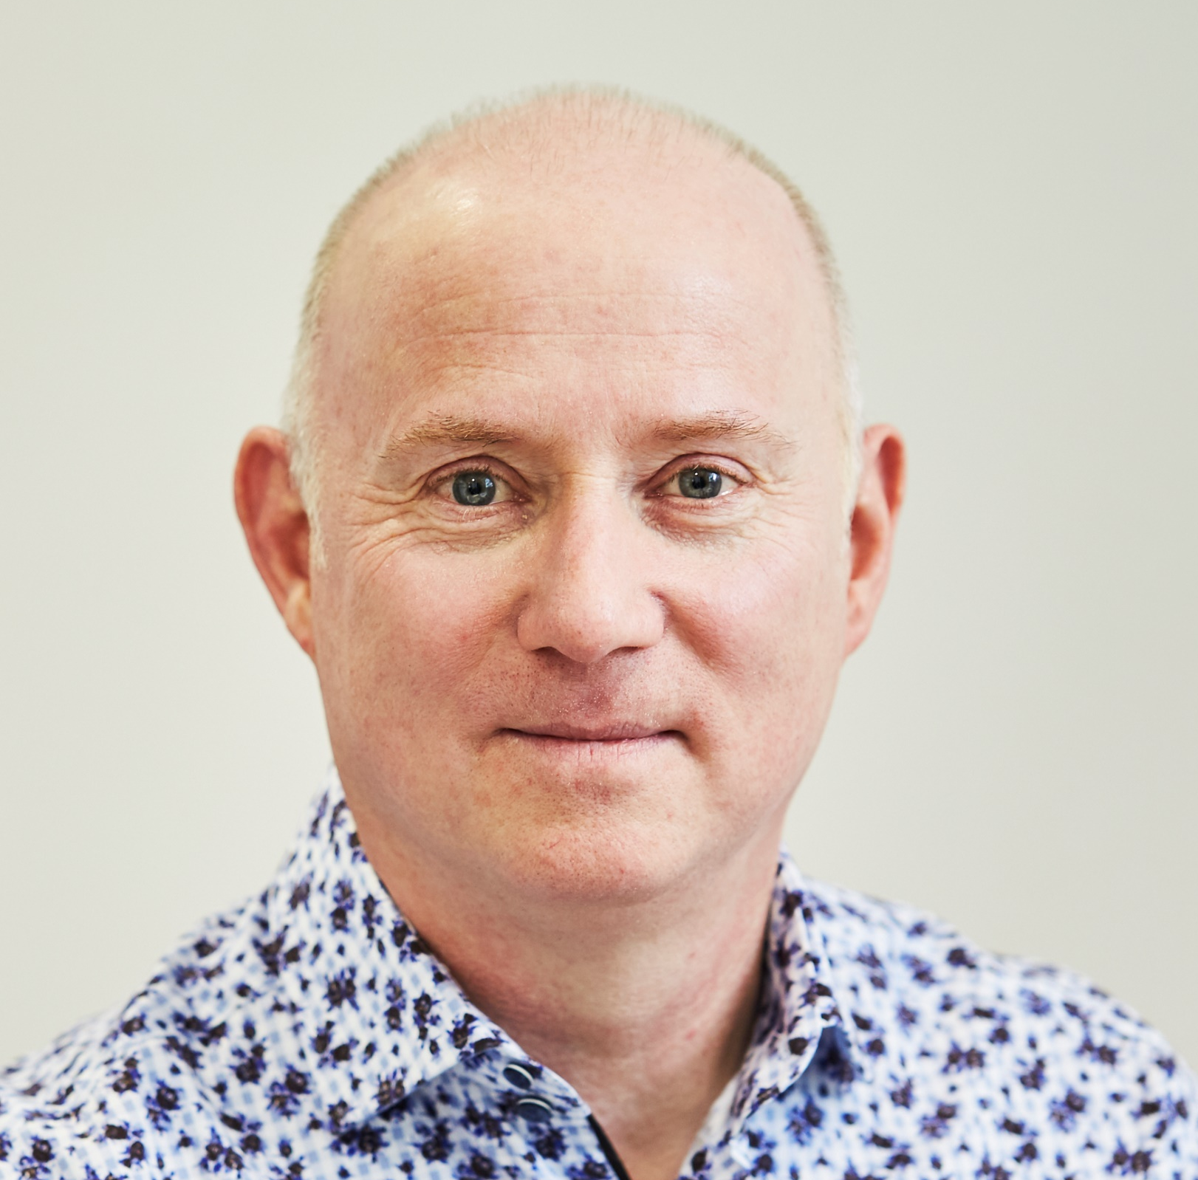


With …
Andy Lancaster
Head of Learning
CIPD
@AndyLancasterUK
Laura Overton
Founder
Learning Changemakers
@LauraOverton
Notes:
Laura background to research – positioning authority but highlighting need to turn data into insight and insight into action – this requires questions, reflection and conversation

Slide 3

Welcome to the webinar
Working in the chat …
For the webinar, frame a question that you need to answer around skills development in your context

Slide 4
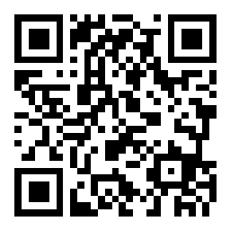
www.slido.com
#CIPDskills

Slide 5
New evidence
New insights
New action
Notes:
Laura background to research – positioning authority but highlighting need to turn data into insight and insight into action – this requires questions, reflection and conversation

Slide 6

The pull of priorities
Business
priorities
Growth
Productivity
Talent
L&D priorities
Aligning with OD
Onboarding
Content quality
Self-directed learning
Skill
Notes:
The tension in priorities is that they business and L&D priorities are pulling in different directions
Data flash : skills priority, people priority, L&D priority
In 2023 our study is showing a potential mismatch of priorities
Organisation and people priorities: growth, costs, productivity: Staff retention, wellbeing, succession planning
L&D priorities - linking learning to OD and performance management (collaborating more with HR) improving onboarding and leadership improving content quality, self directed learning
Main point of commonality between the two is the skills agenda - a priority for both and an opportunity to release tension and pull together

Slide 7

Chat activity
In a sentence …
What’s the key thing you are doing to add value to the skills agenda in your context?

Slide 8
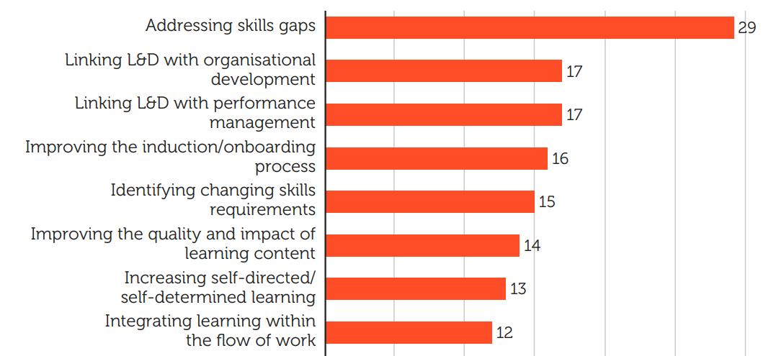
What the research showed was important

Slide 9


















We have more resources available to us than ever before
Methods
Media
Budget
Headcount
Notes:
Insights from CIPD Learning at Work report
Word cloud representing some of the methods and media in use today

Slide 10

53%
of L&D report increased workload in 2023

Slide 11

Slido word cloud
Your key barrier to supporting skills development?
www.slido.com
#CIPDskills
In a word …
What’s your key barrier to supporting skills development?

Slide 12
Learning transformation reality
What got us here won’t get us there
Marshall Goldsmith

Slide 13
Working smarter not harder on the skills agenda
Focus on the right thing
Do the right thing
Share the load
Prepare yourself
Notes:
Laura report highlights a number of areas for us to discuss together

Slide 14
Working smarter not harder on the skills agenda
Focus on the
right thing

Slide 15

57%
of L&D agree they are proactive in identifying the performance issue before recommending a solution
we are working harder but not necessarily on the right thing

Slide 16

Focus on the right thing … 5 practical steps
Address critical opportunities & pain points

Slide 17

Focus on the right thing … 5 practical steps
Address critical opportunities & pain points
Immerse in, and translate strategic priorities

Slide 18

Focus on the right thing … 5 practical steps
Address critical opportunities & pain points
Immerse in, and translate strategic priorities
Ask insightful diagnostic questions

Slide 19

Focus on the right thing … 5 practical steps
Address critical opportunities & pain points
Immerse in, and translate strategic priorities
Ask insightful diagnostic questions
Get close to the action and managers

Slide 20

Focus on the right thing … 5 practical steps
Address critical opportunities & pain points
Immerse in, and translate strategic priorities
Ask insightful diagnostic questions
Get close to the action and managers
Revamp and if needed cull your offering

Slide 21
Slido poll
Choose the 2 things that are you doing the best on?
www.slido.com
#CIPDskills
Address critical opportunities & pain points
Immerse in, and translate strategic priorities
Ask insightful diagnostic questions
Get close to the action and managers
Revamp and if needed cull your offering

Slide 22

67%
Agree that their leaders recognise the impact L&D has on organisational and people priorities

Slide 23
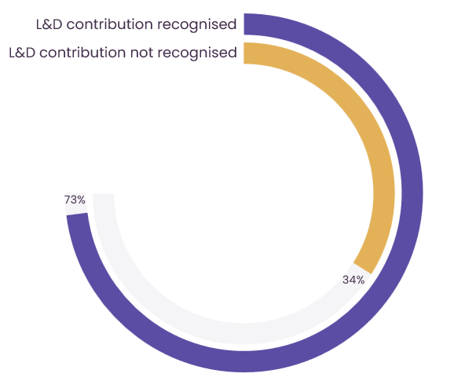
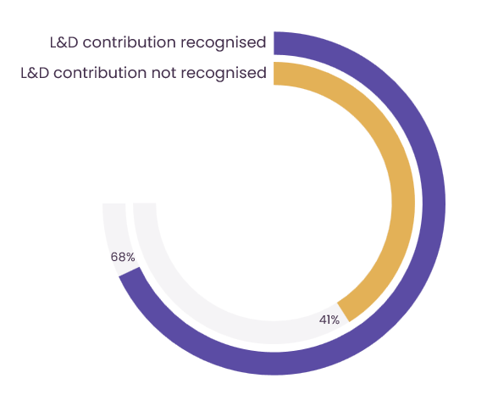
Identify a performance issue before solution
L&D teams whose value is recognized by leaders
Focus on the right thing …
the priorities of the business
Processes in place for continual improvement
Notes:
Introduce concept of organisations where leaders recognise their value – not only doing more of what Andy just said but also more

Slide 24
Working smarter not harder on the skills agenda
Do the right thing

Slide 25


It’s not just about more content!
Notes:
Image credit EliFrancis Pixabay

Slide 26
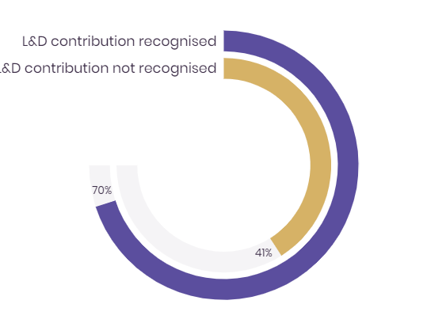
L&D teams whose value is recognized by leaders
Intentionally take action that build skill
Design and make recommendations using evidence informed principles
Notes:
They are also more likely to be
Appling adult learning and motivation theory in practice (28% vs 16%)
Skilled at effective learner engagement, transfer and impact 28% vs 16%
Using a broad range of technologies

Slide 27

Do the right thing … 5 practical steps
Evidence-based practice not good ideas …

Slide 28

Do the right thing … 5 practical steps
Evidence-based practice not good ideas …
Scaffolding and knowledge acquisition

Slide 29

Do the right thing … 5 practical steps
Evidence-based practice not good ideas …
Scaffolding and knowledge acquisition
Peer collaboration

Slide 30

Do the right thing … 5 practical steps
Evidence-based practice not good ideas …
Scaffolding and knowledge acquisition
Peer collaboration
Spaced repetition and practice

Slide 31

Do the right thing … 5 practical steps
Evidence-based practice not good ideas …
Scaffolding and knowledge acquisition
Peer collaboration
Spaced repetition and practice
Reflection

Slide 32

Do the right thing … 5 practical steps
Evidence-based practice not good ideas …
Scaffolding and knowledge acquisition
Peer collaboration
Spaced repetition and practice
Reflection
Promote experimentation, value mistakes

Slide 33

In the chat
Which number has most potential in your context?
Evidence-based practice not good ideas …
Scaffolding and knowledge acquisition
Peer collaboration
Spaced repetition and practice
Reflection
Promote experimentation, value mistakes

Slide 34





Broad range technology users …
Use evidence informed principles
Identify needs before recommending solutions
Experiment more
Process of continual improvement
Plus more likely that business leaders recognise impact
Notes:
Laura Additional thoughts on harnessing technology from the data following the conversation
Use this to hand over to Andy

Slide 35
Working smarter not harder on the skills agenda
Share the load

Slide 36
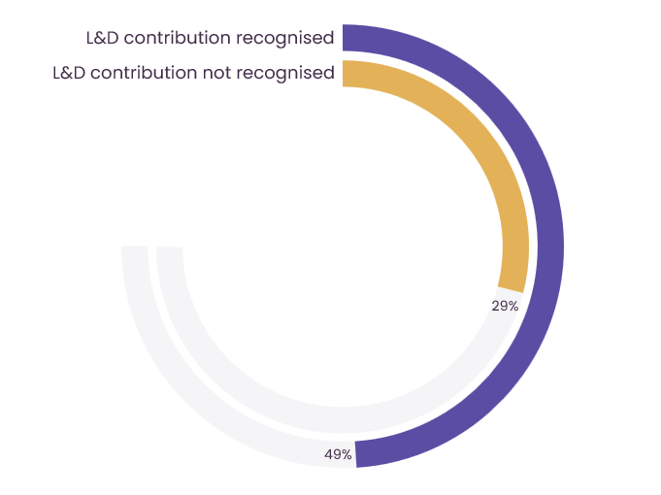
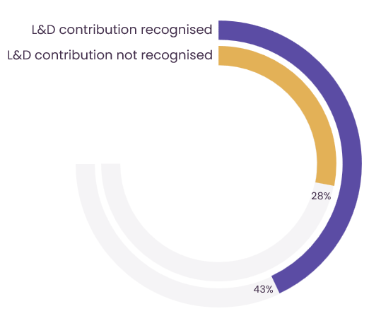
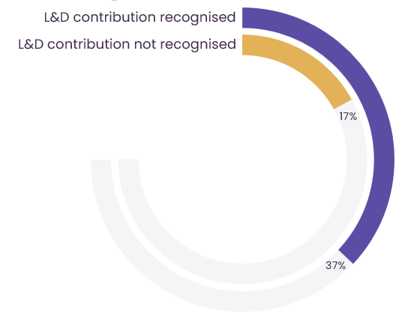
L&D teams whose value is recognized by leaders
Work in environments open to learning
Systems are in place for sharing and capturing ideas
Managers facilitate continuous learning
Organisational
climate of trust

Slide 37

Work smarter with managers versus ‘blaming’ them
Only 29% agree that
line managers are
equipped to support
team learning
Notes:
Top barriers – lack of engagement, lack of commitment but managers are more engaged now than 2 years ago – 7 in 10 don’t feel managers are equipped to take their role – lets do something about that!

Slide 38
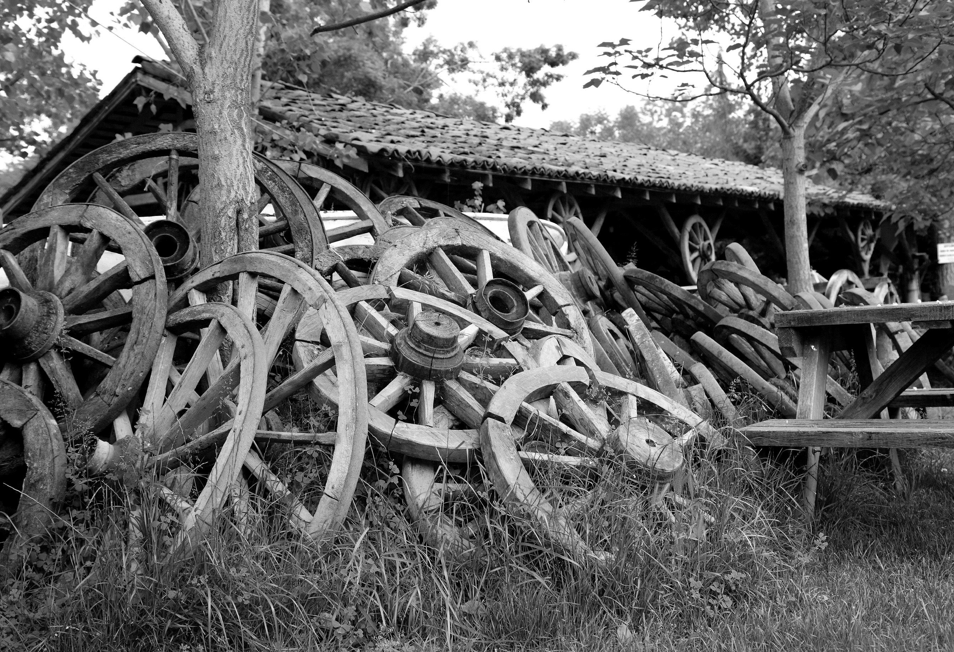
Share the load … 5 practical steps
Don’t reinvent the wheel source great ideas

Slide 39
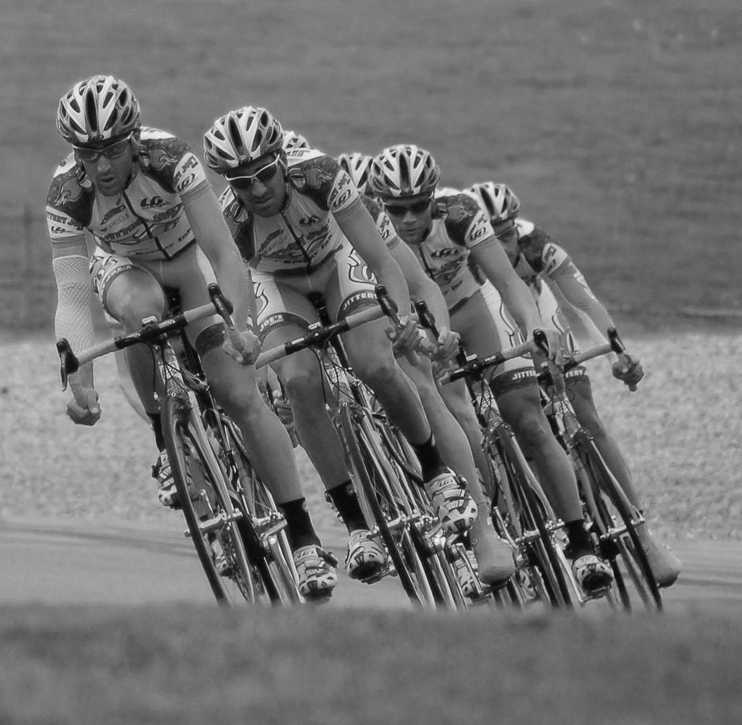
Share the load … 5 practical steps
Don’t reinvent the wheel source great ideas
Sprint teams to solve problems

Slide 40

Share the load … 5 practical steps
Don’t reinvent the wheel source great ideas
Sprint teams to solve problems
Secondments … both ways

Slide 41

Share the load … 5 practical steps
Don’t reinvent the wheel source great ideas
Sprint teams to solve problems
Secondments … both ways
Involve and equip managers

Slide 42

Share the load … 5 practical steps
Don’t reinvent the wheel source solutions
Sprint teams to solve problems
Secondments … both ways
Involve and equip managers
Build a business case for more resource

Slide 43
Working smarter not harder on the skills agenda
Prepare yourself

Slide 44
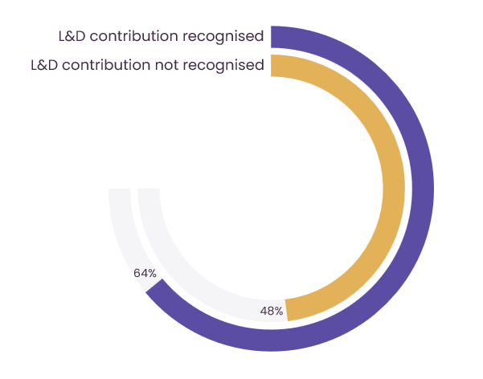
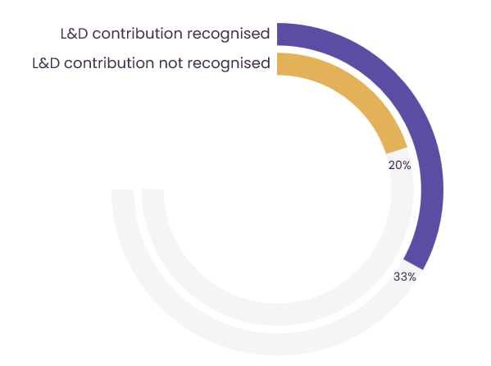
L&D teams whose value is recognized by leaders
Invest in themselves
Has a commitment to evolving its practice
Has permission to experiment

Slide 45
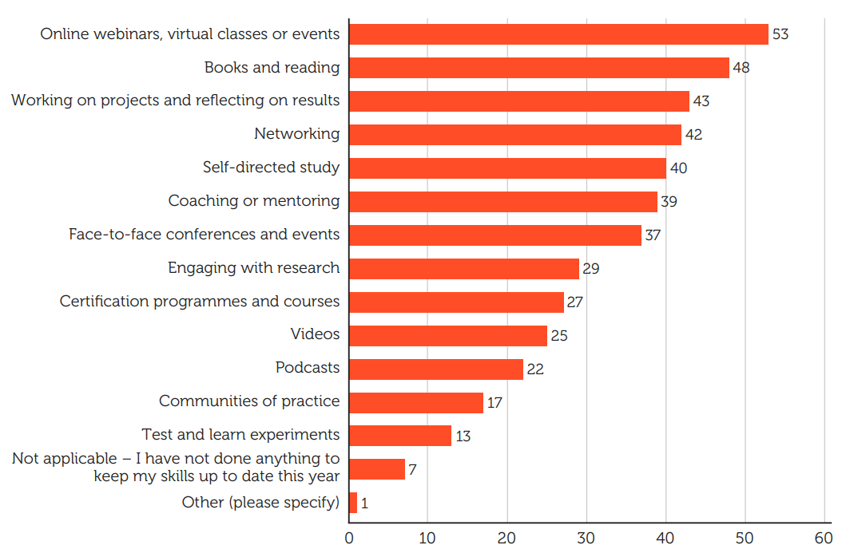



How have learning practitioners been updating skills?
Education
Exposure
Experience

Slide 46

Slido word cloud
How do you develop yourself?
www.slido.com
#CIPDskills
What key thing do you do to develop and prepare yourself?

Slide 47
Working smarter on the skills agenda
Now what?
Notes:
Turning insight into action

Slide 48


88%
21%
Time for smart action
of Learning practitioners agree that L&D offers a meaningful career
of Learning practitioners strongly agree that they cultivate their own attitude of continual improvement

Slide 49
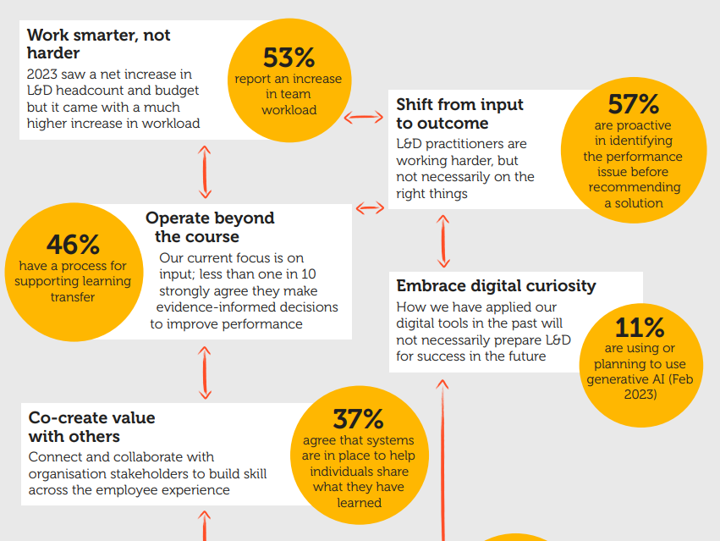

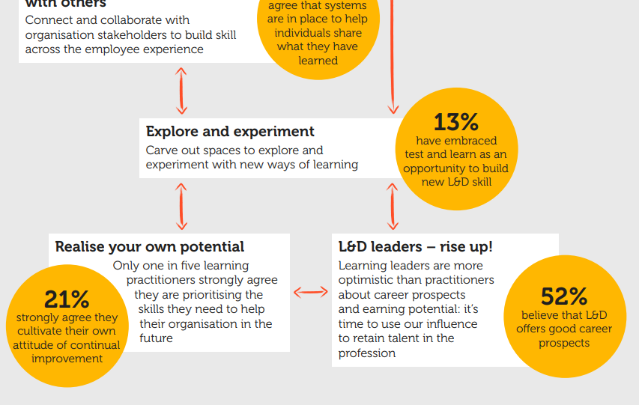
Focus on the right thing
8 lessons from
the CIPD
Learning at Work 2023 Survey Report
Do the right thing
Share the load
Prepare yourself

Slide 50
Focus on the right thing
8 lessons from
the CIPD
Learning at Work 2023 Survey Report
Do the right thing
Share the load
Prepare yourself

Slide 51
Focus on the right thing
8 lessons from
the CIPD
Learning at Work 2023 Survey Report
8 lessons from the
CIPD Learning at Work 2023 Survey Report
Do the right thing
Share the load
Prepare yourself

Slide 52
Focus on the right thing
8 lessons from
the CIPD
Learning at Work 2023 Survey Report
Do the right thing
Share the load
Prepare yourself

Slide 53
Thanks for joining us …
Click the link in the chat box to download the report
Notes:
Learning at work 2023 | CIPD

