Slide 1
Unlock Your Career Potential by Gaining Chartered Membership
12 February, 2025
12:00- 13:00

Slide 2
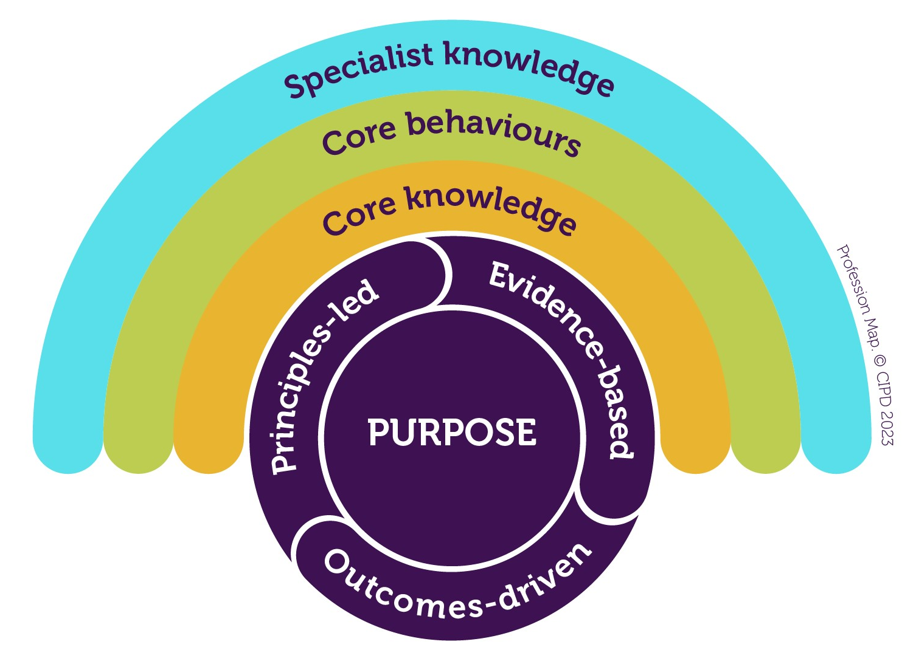
The CIPD Profession Map
Sets out the international standard for people professionals to make their greatest impact and thrive in a changing world of work.

Slide 3




Membership grades
Foundation Member
People professionals who apply their knowledge to deliver strong tactical support.
Associate Member
People professionals whose work is operational with some complexity: you’re beginning to contribute thinking to people issues and solutions.
Chartered Member
People professionals who work strategically and operationally with some complexity. You’re actively driving and managing change.
Chartered Fellow
People professionals who combine strategic insight and people expertise with commercial acumen, to change the way organisations think.

Slide 4
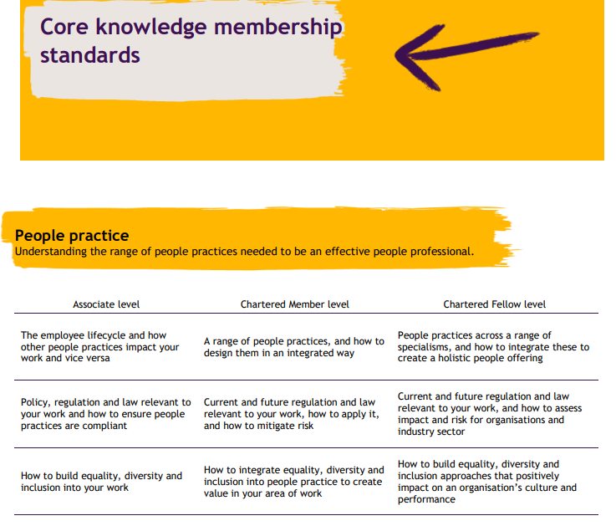
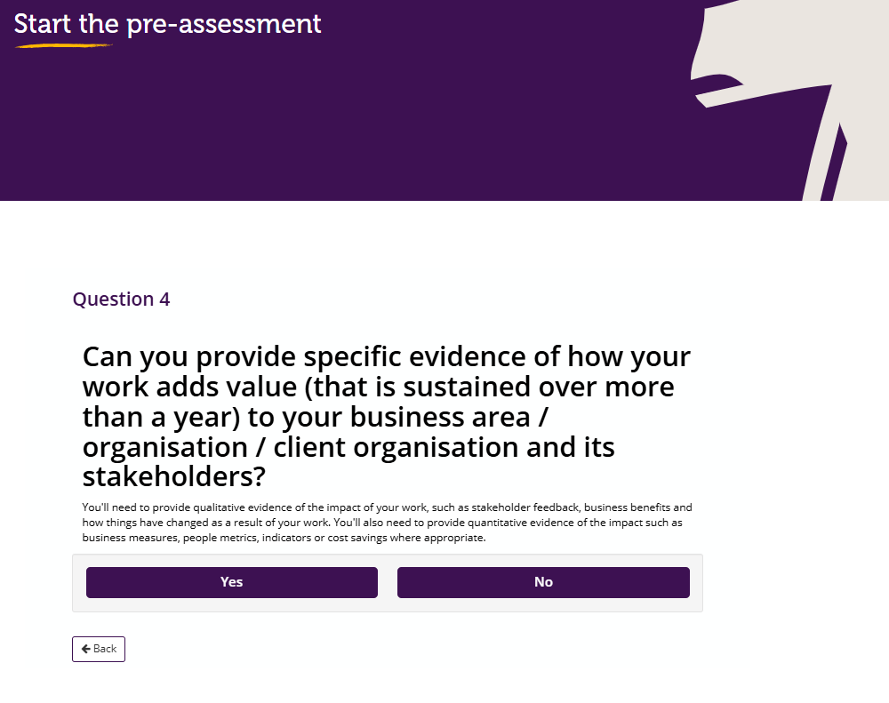
Membership Standards to support your development

Slide 5






‘Routes’ to Chartered
I’m an existing Chartered Member
I’ve completed a L7 Diploma to achieve Associate Member
I’ve never been a member
I’m an Associate Member
Upgrading Assessment
Experience Assessment

Slide 6
Your routes to and through membership
Foundation Member
Associate Member
Experience Assessment
Chartered Member
Upgrade Assessment
Experience Assessment
Chartered Fellow
Upgrade Assessment
Experience Assessment

Slide 7





What to expect: Experience Assessment
Complete the pre-assessment tool
Complete your written documents
Book your
Assessment
Have your
Professional Discussion
Get your results within 4 weeks

Slide 8
What to expect: The Upgrade Assessment
Complete the pre-assessment tool
Book your Assessment
Have your Professional Discussion
Get your results within 10 days

Slide 9
Preparing your examples
Organisation strategy and the people strategy
Leading a people approach
Leading change
People capability
Impact

Slide 10

What we mean by impact
The value your work creates for stakeholders
Not the output of your work, but how your work has met the needs of stakeholders in different ways.
1. What you did
2. Output
3. Impact
Quantitative and qualitative evidence

Slide 11
How to prepare: some practical tips
Take the pre-assessment tool for upgrading or experience assessment
Reflect on your experiences
Gather your examples
Engage with peers
Seek feedback
Stay positive and seek support

Slide 12

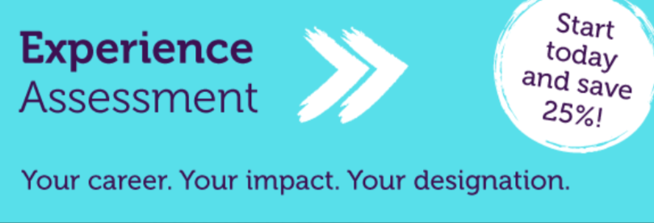
Offers & Campaigns
* 25% off your Experience Assessment fee if you register on or before the 31st of March 2025
* Upgrade for free if you book your upgrade assessment before the 28th of February 2025

Slide 13
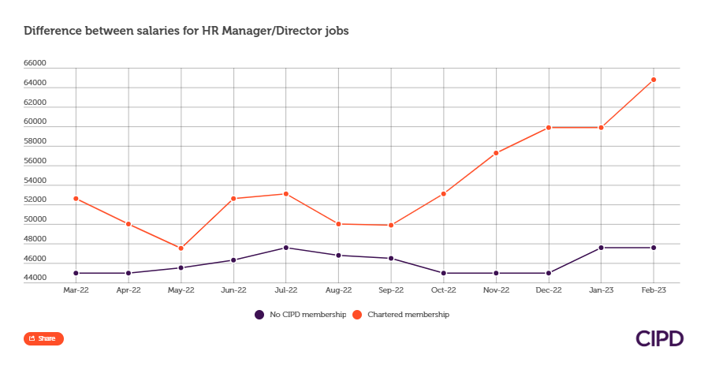
Final thought…
In 2023, HR job postings requesting Associate CIPD member candidates paid up to £5,440 (18%) and on average £4,480 (15%) more than those not hiring CIPD members.
In 2023, HR-officer job postings requesting Associate CIPD member candidates paid up to £5,952 (21%) and on average £3,904 (13%) more than those not hiring CIPD members.
In 2023, HR-manager/director job postings requesting CIPD chartered member (MCIPD) candidates paid up to £15,808 (37%) and on average £11,968 (28%) more than those not hiring CIPD members. (Graph shown)
*Source: Lightcast™, accessed 20/02/2024. Lightcast data is created from a collection of government sources that are combined to provide multi-layered cross-checking. These sources are collected and combined to create Lightcast’s industry and occupation data, as well as staffing patterns used to connect the two. Twice a year, Lightcast updates its data with more than 20 million data points describing labour market conditions across the United Kingdom. It is the most accurate and reliable source of labour market information available today.

