Slide 1


AI in the workplace: what’s ethical?
Webinar
Monday 17 July, 12:00 – 13:00

Slide 2
Welcome
Katie Jacobs
Senior Stakeholder Lead, CIPD

Slide 3
Today’s speakers
David D’Souza
Membership Director, CIPD
Dr Abigail Gilbert
Director of Praxis, Institute for the Future of Work (IFOW)
Andrew Stephenson
Chief People Officer, Equiniti

Slide 4










#StrongerWithCIPD
Covid-19 resources
NEW Well-being helpline
Employment Law helpline
Communities and branches
People Management
Knowledge and content
Free learning
Careers support
Professional creditability
Financial support
cipd.org/uk/membership/member-benefits/

Slide 5

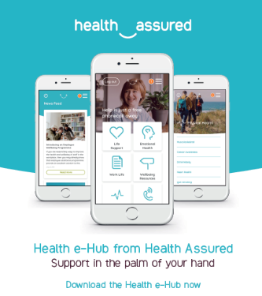
Wellbeing Resources
We’ve partnered with Health Assured to support members mental health and wellbeing
Unlimited free 24/7 confidential telephone helpline, online portal & Health e-Hub app
The resource provides:
  Legal information
  Debt and financial information
  Manager consultancy and support
  Information on work and home issues
  Factsheets, advice, information and self-help tools
  Links to specialist support organisations
  A resources area with; programmes, videos, webinars, medical information and mini health checks.
Notes:
In recognition of the increased pressure and personal challenges many of you might currently be facing we’re launched a new Well-being helpline for the UK and Ireland. Calls are FREE and confidential. Phonelines are open 24 hours a day, 7 days a week, 365 days a year.
Work through your problems with a qualified therapist accredited by the British Association for Counselling and Psychotherapy (BACP).
Legal information services - support on a range of issues including personal, financial and legal matters.
Debt and financial information - support for issues such as debt, investments, pensions, managing money, negotiating with creditors.
Manager consultancy and support - at helping people managers to support their teams effectively.
Plus there are online resources and a well-being app you can download.

Slide 6


Responsible AI
How to Forefront Good Work Through Transition
Dr Abigail Gilbert
Institute for the Future of Work

Slide 7
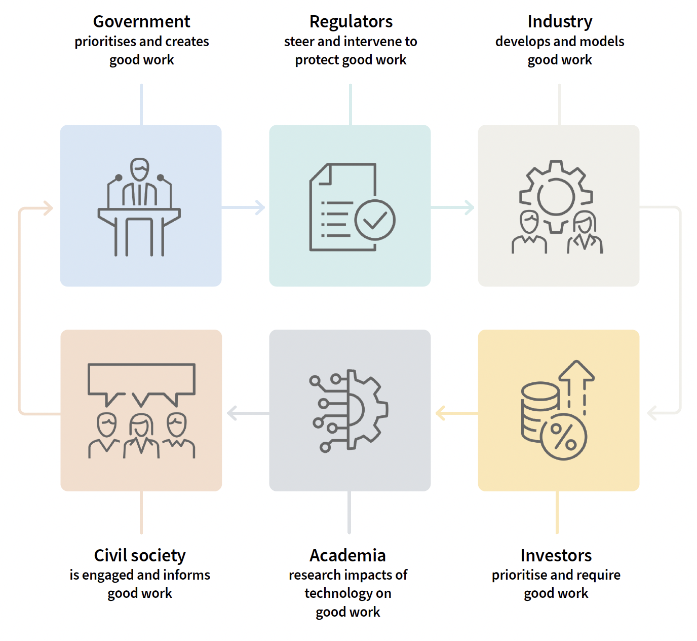
We work at the intersections of governance, civil society and industry to build, through good work,
a good society in which everyone can flourish through this new technological revolution.
Director and Co-Founder, IFOW

Slide 8


Slide 9
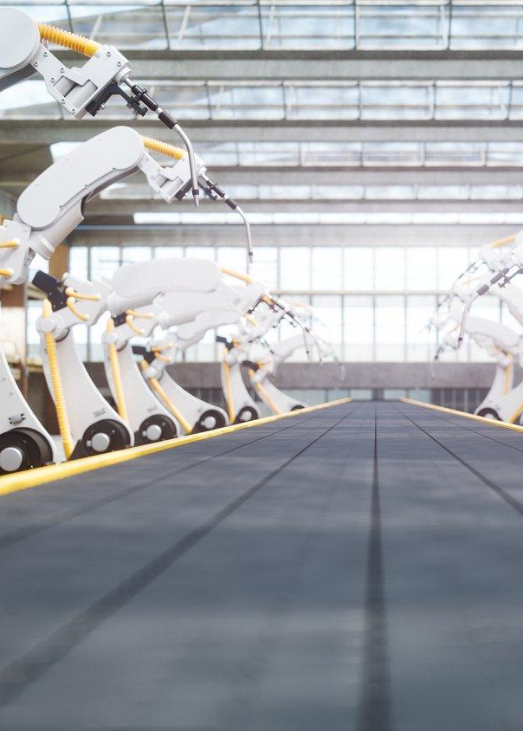




Identify trajectories and impacts of automation disruption
Understand technology adoption across UK firms
Understand impacts of automation on workers’ wellbeing
Understanding impacts and implications for institutions
Policy impacts
DISRUPTION INDEX
FIRM LEVEL TECHNOLOGY SURVEY
LOCAL AREA INTERVIEWS & CASE STUDIES
INSTITUTIONAL ANALYSIS
POLICY IMPACTS

Slide 10
Results from a new survey of 1000 UK firms
80% have deployed automation in past 3 years
Same proportion for physical and cognitive tasks
Implication: lots of job churn / lots of support needed for workers through this transition
Better outcomes (increase in job quality / job creation) comes with
‘Regional Innovation Readiness’
More important for HR sector: research finds that Human Resource Management practices are an important factor.
Where HRM is better, and RIR is in place, automation improves job quality and job creation.
When it’s lacking, automation drives down job quality.
Director and Co-Founder, IFOW

Slide 11
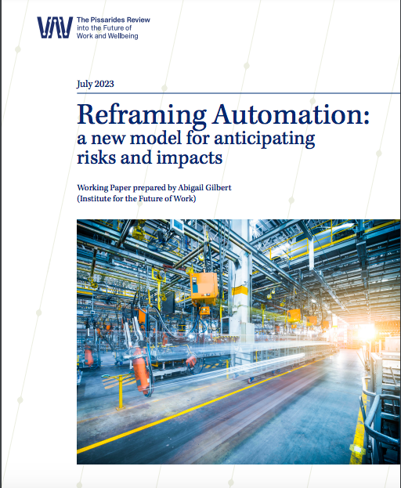

Slide 12
The Good Work Algorithmic Impact Assessment (‘GWAIA’) is intended to
Unlock and share information about the impacts of algorithmic systems on work and people
Introduce new safeguards when AI and algorithmic systems are used at work
Mitigate risks and maximise benefits as work transforms
Shift focus towards pre-emptive action from damage control
Develop process and forums for ongoing scrutiny by union representatives
Director and Co-Founder, IFOW

Slide 13
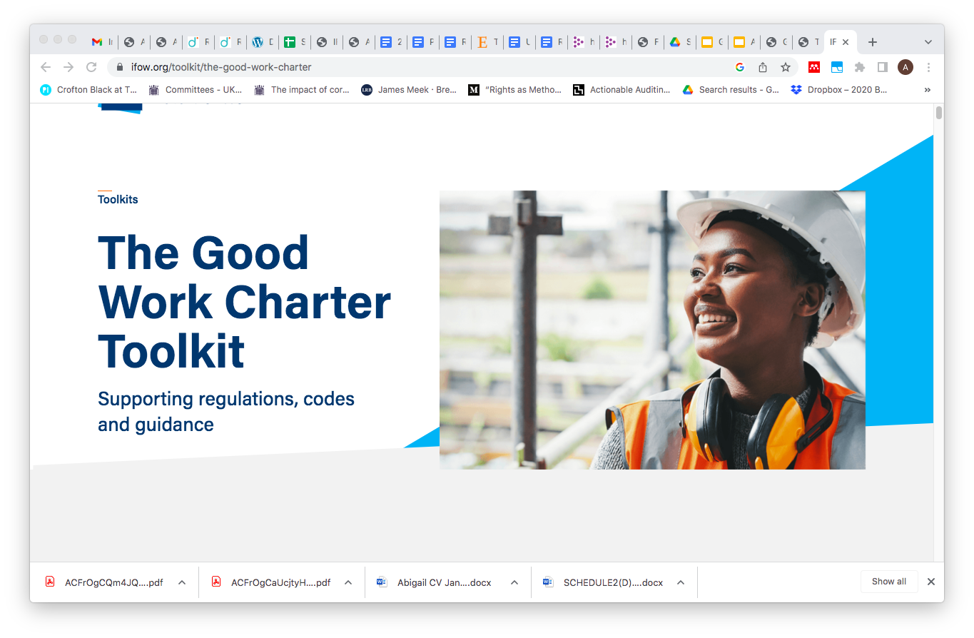
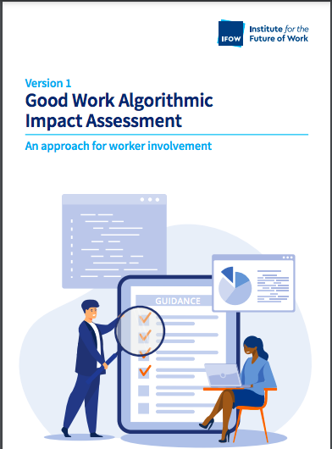
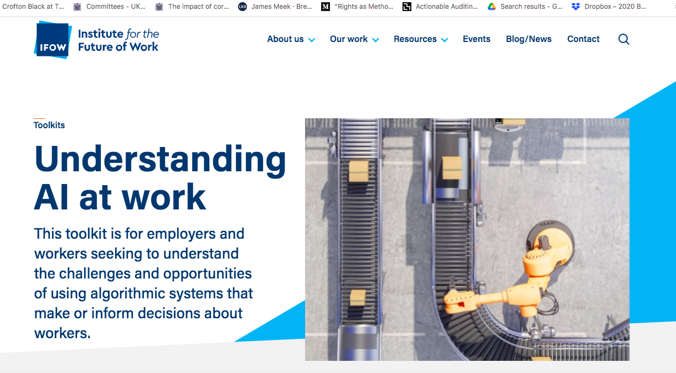

Slide 14
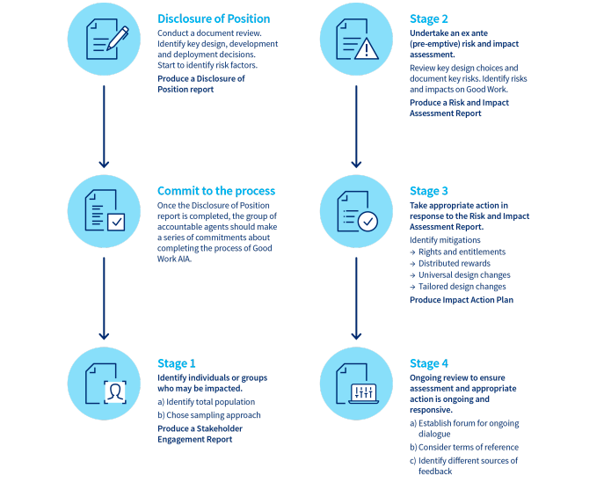

Slide 15
Trailblazer Organisations
IFOW has established a Lab to pilot these methods with business.
We will bring in a cohort of only those who are advanced in deployment of AI to pilot new approaches, and learn from each other.
This is supported by a range of regulators, and CIPD.
Through this we hope to ensure innovation is responsible, and regulation is responsive.
Director and Co-Founder, IFOW

Slide 16
Questions
Please share any questions you have for our panellists using the Q&A tab.

Slide 17
Wellbeing Resources
We’ve partnered with Health Assured to support members mental health and wellbeing
Unlimited free 24/7 confidential telephone helpline, online portal & Health e-Hub app
The resource provides:
  Legal information
  Debt and financial information
  Manager consultancy and support
  Information on work and home issues
  Factsheets, advice, information and self-help tools
  Links to specialist support organisations
  A resources area with; programmes, videos, webinars, medical information and mini health checks.
Notes:
In recognition of the increased pressure and personal challenges many of you might currently be facing we’re launched a new Well-being helpline for the UK and Ireland. Calls are FREE and confidential. Phonelines are open 24 hours a day, 7 days a week, 365 days a year.
Work through your problems with a qualified therapist accredited by the British Association for Counselling and Psychotherapy (BACP).
Legal information services - support on a range of issues including personal, financial and legal matters.
Debt and financial information - support for issues such as debt, investments, pensions, managing money, negotiating with creditors.
Manager consultancy and support - at helping people managers to support their teams effectively.
Plus there are online resources and a well-being app you can download.

Slide 18
#StrongerWithCIPD
Covid-19 resources
NEW Well-being helpline
Employment Law helpline
Communities and branches
People Management
Knowledge and content
Free learning
Careers support
Professional creditability
Financial support
cipd.org/uk/membership/member-benefits/

