Slide 1
CIPD
Webinar Series
Embedding flexible working for all
01 March 2021

Slide 2
Welcome
Daphne Doody, Head of CIPD Northern England, CIPD

Slide 3

cipd.co.uk/news-views/campaigns/flex-from-first

Slide 4
Today’s speakers
Daphne Doody
Head of CIPD Northern England,
CIPD
Ben Willmott
Head of Public Policy, CIPD
Charlotte Gascoigne
Flexible Working Consultant and Researcher
Vicki Casey
Head of HR Business Partnering, University of Sunderland

Slide 5










#StrongerWithCIPD
Covid-19 resources
NEW Well-being helpline
Employment Law helpline
Communities and branches
People Management
Knowledge and content
Free learning
Careers support
Professional creditability
Financial support
cipd.co.uk/memberbenefits

Slide 6
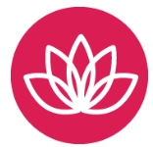
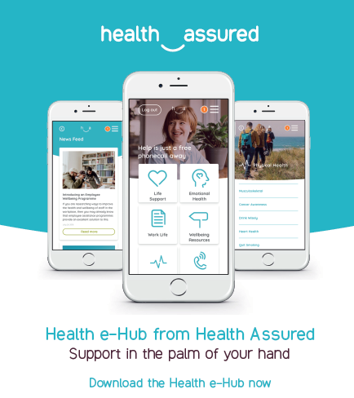
*New* Wellbeing Resources
We’ve partnered with Health Assured to support members mental health and wellbeing
Unlimited free 24/7 confidential telephone helpline, online portal & Health e-Hub app
The resource provides:
  Legal information
  Debt and financial information
  Manager consultancy and support
  Information on work and home issues
  Factsheets, advice, information and self-help tools
  Links to specialist support organisations
  A resources area with; programmes, videos, webinars, medical information and mini health checks.

Slide 7
Embedding flexible working for all
Ben Willmott
CIPD Head of Public Policy

Slide 8
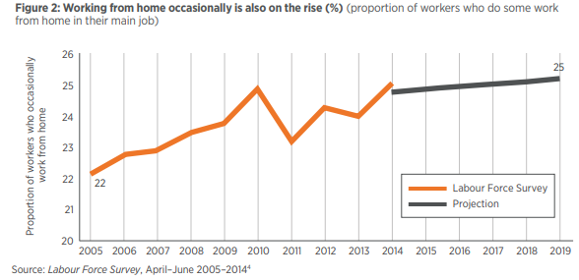
Homeworking before the pandemic
“We can confidently assert that around three in ten people work from home, exclusively or occasionally”, CIPD Labour Market Economist Jon Boys

Slide 9
Proportion of workforce that has typically worked from home since the start of the pandemic (%)
All of the time 24
Most of the time 14
Some of the time 17
None of the time 44

Slide 10
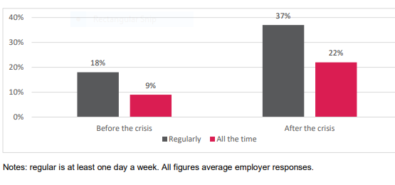
Homeworking set for sustained increase post-crisis (%)

Slide 11
However much less focus on other forms of flexible working
Nearly half of organisations (47%) plan to take steps to enable more home and hybrid working over the next six to 12 months
But less than a third (30%) of the 2,000 employers surveyed are planning to try to increase the uptake of other forms of flexible working besides home working over the same period.

Slide 12
Do you have flexibility in your current role?
Yes 54%
No 46%

Slide 13
Besides home working, what common flexible working practices do people currently use and what would they choose? (%)
Use Choose
Annualised hours 4 12
Flexi-time 21 39
Term-time working 4 9
Job share 2 5
Compressed hours 3 19
Part-time hours 19 28

Slide 14

Employee views on home/flexible working
74% agree it is important people who can't work from home can work flexibly in other ways
41% agree it is unfair that some people can work from home while others have to continue to attend their employer's workplace and have little flexibility
38% agree their employer seeks to provide choice to people over when and where they work
49% agree they are able to work flexibly in the way that best suits their life at the moment
43% say they have very limited flexibility in the way they currently work

Slide 15


Slide 16
Flexible Working Taskforce reconvened for 2021
BEIS Small Business Minister Paul Scully has written to CIPD CEO Peter Cheese asking him to co-chair the taskforce
Membership includes BEIS, Treasury, DWP, Acas, CBI, BCC, FSB, REC, TUC, Working Families, Timewise
Review of hybrid working practices and creation of best practice guidance
Explore what can be done to support and promote informal ‘adhoc’ or non-contractual flexible working
The taskforce will also feed into forthcoming consultation on ‘making flexible working the default’

Slide 17
Embedding flexible working for all
Dr Charlotte Gascoigne
1. #FlexFrom1st = important principle
2. Homeworking and the pandemic
3. Flexibility of hours
4. The business case

Slide 18
Opportunities for negotiating flexible working
Point of hire
Personal request
Annual review
Organisational initiative
Market shock

Slide 19





Voluntary and involuntary homeworking: the hygiene factors

Slide 20




Flexible location: hybrid and homeworking

Slide 21
What does the research tell us about homeworking?
Work-life boundaries
Concentration
Productivity
Tasks and processes
Long-term impacts

Slide 22




Flexible hours

Slide 23
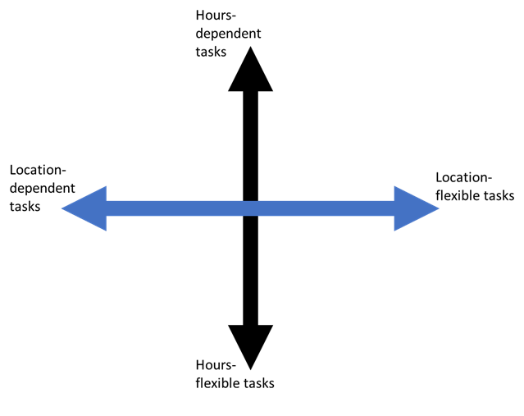
Identifying tasks that are hours-flexible and tasks that are location -flexible

Slide 24

The business case for flexible working needs more work

Slide 25
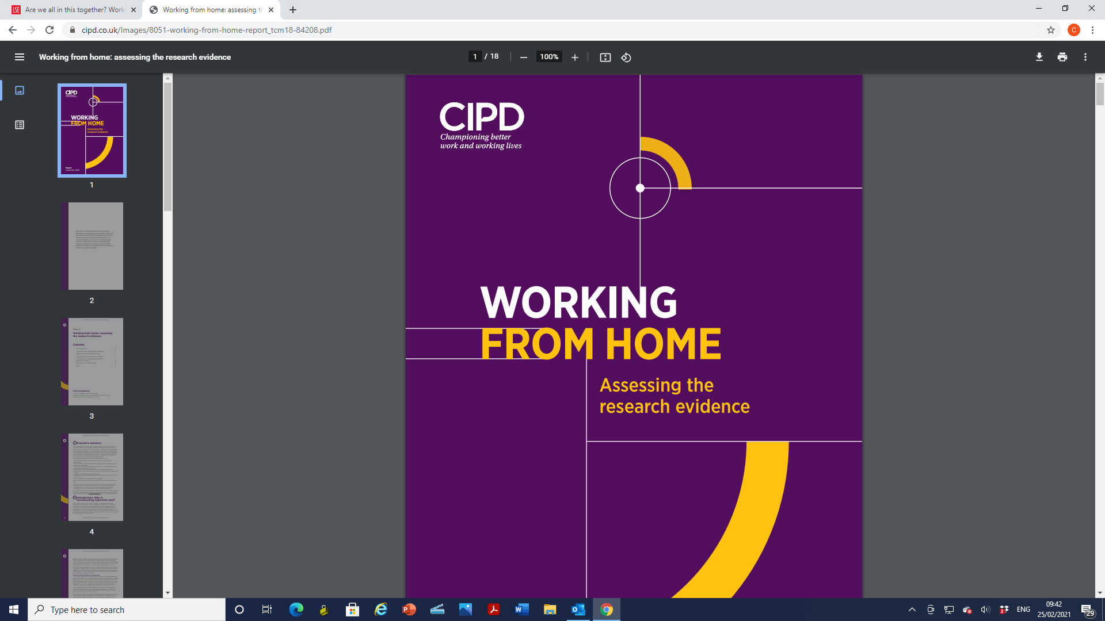
Flexible working: lessons from the pandemic
CIPD April 2021

Slide 26
University of Sunderland - Flex Select scheme
Vicki Casey, Head of HR Business Partnering,
University of Sunderland

Slide 27
Compassionate bereavement support
Background
Business drivers
Impact of the pandemic on working life
Discuss what they would like communicated
Inclusivity, wellbeing and engagement

Slide 28

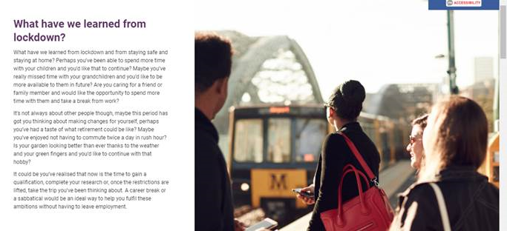
Flex Select Scheme
Preparation and stakeholder involvement
Widening access and eligibility
Branding and website
Exploring needs and advising on the right ‘product’
Line manager training and support

Slide 29
Impact and
Next Steps
Supported 34 staff to work flexibly
Staff cost savings
Cultural shift – informal feedback
What’s next?

Slide 30
Top tips and takeaways
Involve stakeholders
Branding/sales
approach
Low friction
Having a
‘face and voice’
Use of video
case studies

Slide 31
Questions
Please submit your questions for:
  Ben Willmott, Head of Public Policy, CIPD
  Dr Charlotte Gascoigne, Flexible Working Consultant and Researcher
  Vicki Casey, Head of HR Business Partnering, University of Sunderland
Please use the Q&A function to submit your questions

Slide 32
#StrongerWithCIPD
Covid-19 resources
NEW Well-being helpline
Employment Law helpline
Communities and branches
People Management
Knowledge and content
Free learning
Careers support
Professional creditability
Financial support
cipd.co.uk/memberbenefits

