Slide 1
Creating menopause-friendly workplaces
Rachel Suff, Senior Policy Adviser

Slide 2

What is the menopause?
Natural part of ageing, typically happens age 45-55, when a woman’s hormone levels decline and she stops having periods.
As menopausal symptoms are typically experienced for several years, best described as a ‘transition’.
The ‘perimenopause’ is the phase leading up to the menopause, when a woman’s hormone balance starts to change.
Women can go through a wide range of physical and psychological symptoms, which can last for up to 12 years…

Slide 3
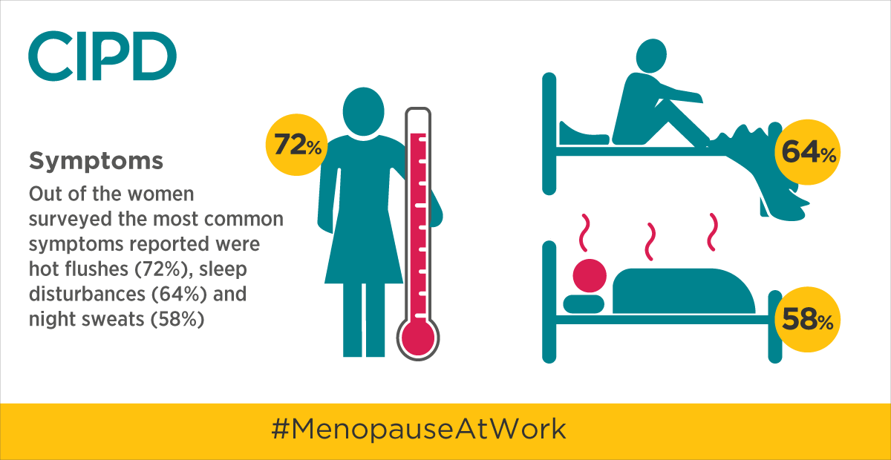
Common menopause symptoms

Slide 4
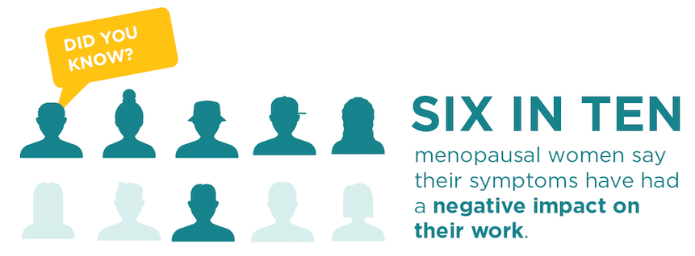

Slide 5
How have you been affected at work due to symptoms of the menopause?

Slide 6

Why is the menopause a workplace issue?
Nearly 4 million women age 45-55 in work (ONS 2021), over 12% of the UK workforce
Important recruitment and retention issue to tap into female talent
Strong compliance case – UK: duty of care for employees’ health and wellbeing and under the Equality Act 2010
It’s the right thing to do!

Slide 7
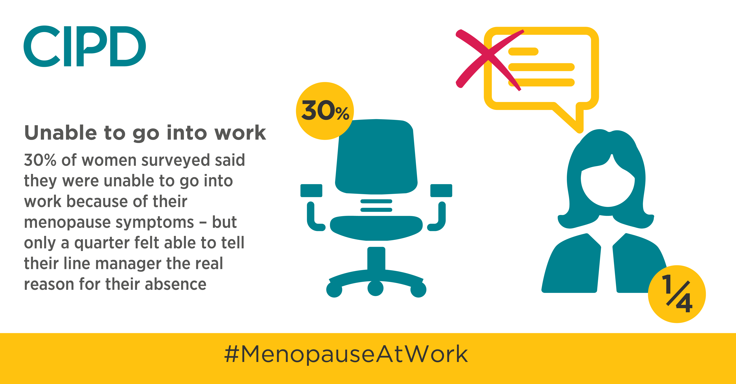

Slide 8
Creating a menopause-friendly workplace
Open up the culture and start talking
Develop a supportive framework
Manage health/absence
Educate and train line managers

Slide 9
Line managers…the common thread
Educated and aware about menopause
Open and inclusive
Sensitive
1-2-1s
Policies and support
Practical adjustments

Slide 10
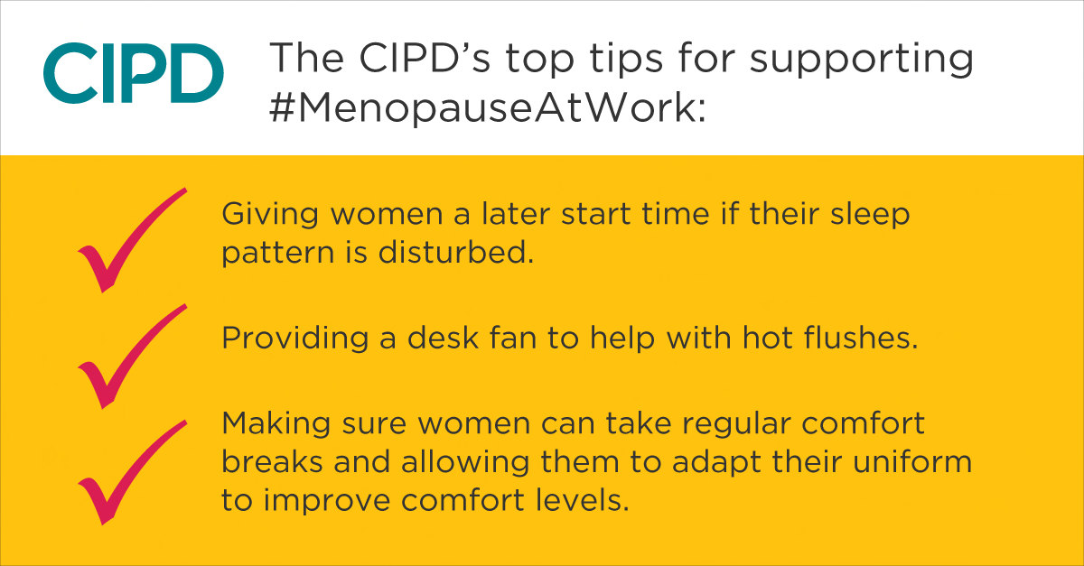
What adjustments can help?

Slide 11
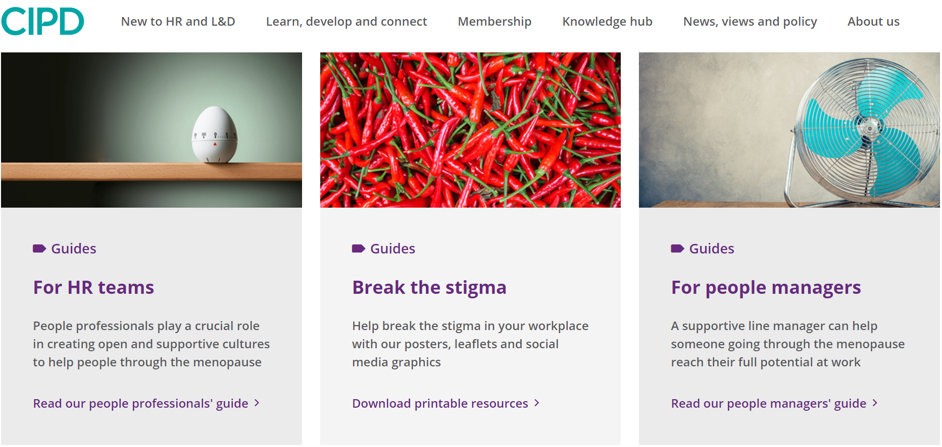
CIPD hub page and practical guidance
www.cipd.co.uk/menopause

